Slide 1
Foundation Trainee Pharmacist Training Programme Lister Hospital
Programme Directors
Surinder Bhatia and Rachel Holland

Slide 2
Contents
Overview of the Trust
Foundation training places
Location
Our ICS
Our Values
The Pharmacy Department
Why Lister Hospital?
What we are looking for?
Our Designated Supervisors and Programme Managers
Structure of the Foundation Training year
HEE training to ICS trainees
Working Hours
What is expected of you ?
Interim Learning outcomes and recording evidence
The registration assessment
Pharmacist Retention
ORIEL recruitment system
Contact Information

Slide 3
Foundation Trainee Pharmacists Places
7 Foundation Trainee pharmacist places :
5 full hospital places
2 split hospital/GP place with 13 weeks in a local GP practice
Hailey View Surgery, Hoddesdon
Stort Valley & Villages Locality Group, Bishops Stortford
Salary - Band 5 - £25,655
Trainees ranked us top out of 21 sites in East of England in a recent survey of hospital training sites (April 2019).

Slide 4
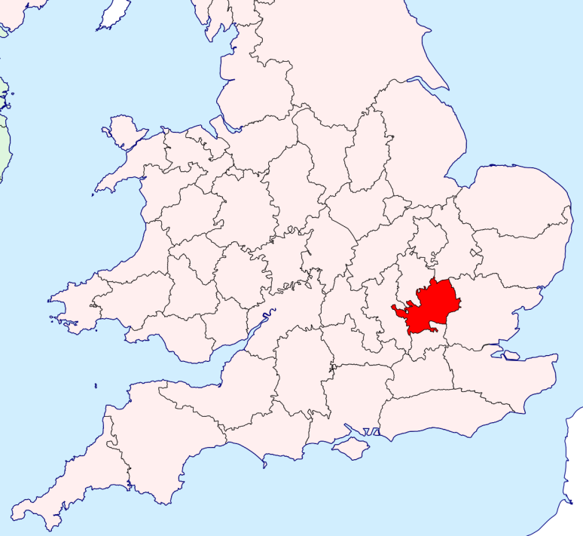
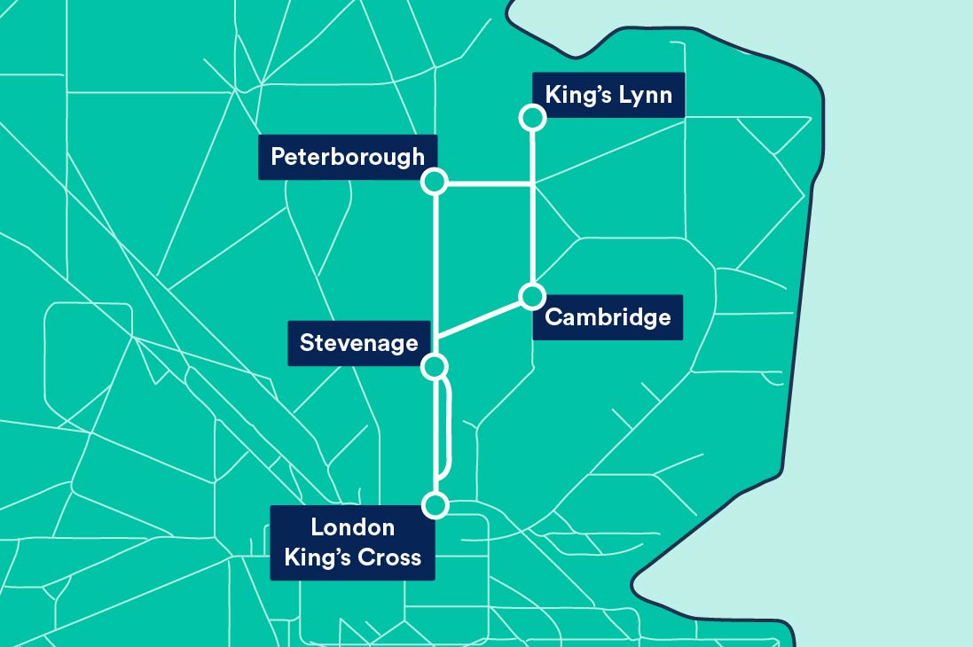
Where are we ?
Hertfordshire
Stevenage
Semi rural location close to Stevenage town centre.
Close to historic towns – St Albans, Hitchin and Hertford
20 Minutes from central London, regular trains to Kings Cross and St Pancras
Easy access to London, Cambridge, Oxford and M1, M25 and M11

Slide 5
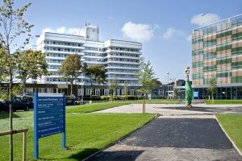
East & North Hertfordshire NHS Trust - Lister Hospital
Hertfordshire & West Essex Integrated Care System (ICS)
Lister Hospital
Princess Alexander Hospital
Watford General Hospital
All PCN’s
Community Trusts
Mental Health Trusts
FUN FACTS
Named after Joseph Lister
Pioneer of antiseptics in surgery
Listerine mouthwash
Listeria genus
730 bed Acute Trust
Renal specialist centre & dialysis unit
Urology – robotic surgery
160 pharmacy staff
60 Pharmacists

Slide 6
Pharmacy Department – 160 staff
60 pharmacists
Clinical Specialists
Education & Training
Antimicrobial
Medicines Information
Aseptics & Oncology
Formulary
Patient Safety
EMPA
TEAMWORK
COMMUNICATION
COLLABORATION
+++++++
Pharmacy Technicians
Medicines management pharmacy technicians - on wards
Patient safety
Procurement
Discharge Planning
Dispensary
Aseptics & Oncology
Assistants
Medicines Management –on wards
Dispensary
Aseptics and Oncology
Stores

Slide 7
Why choose us?
Friendly supportive department
Excellent team of clinical pharmacists
Dedicated support from programme directors with regular meetings
Training provided in each rotation by highly experienced specialists
One to One support from Designated Supervisors
Exposure to a broad range of clinical specialities at a large training site
Opportunities to attend national and local courses
An interesting rota through different departments, specialities and placements
We think of it as YOUR year, and allow you to influence the programme

Slide 8
Excellent learning opportunities
In-house patient consultation course
Regular bite-sized training sessions
Regular lunchtime learning sessions
In house mock exams and training sessions
Calculations practice and mock papers
A chance to work with lots of different people, in lots of different clinical settings

Slide 9
Clinical Specialities at Lister
Surgery
general, orthopaedic, vascular, urology, plastics
Medicine
Acute, respiratory, gastroenterology, endocrinology, cardiovascular
Paediatrics and Neonatology
Obstetrics and Gynaecology
Renal Medicine
Oncology & Haematology
Palliative care
Critical Care

Slide 10
Attributes of a good Foundation Trainee pharmacist
Dedicated to patient care
Highly organised
Ability to work under pressure
Ability to work in a team
Be able to take advantage of every learning opportunity
Be open to receiving feedback and actively seek it
Notes:
Ability to manage UEA & exam revision workload on top of a busy ‘day job’

Slide 11
Our Designated Supervisors
Emily Ah-Moye
Amaia Martinez
Tasia Somers
Fadia Alsheikh
Mark Brooks
David Roberts
Emily Clifford
Notes:
Trainees will meet with designated supervisors every 2 weeks and with Foundation Trainee managers approximately every 8 weeks

Slide 12
Foundation Training Manager - Rachel Holland
MPharm University of Nottingham
Foundation Trainee at Glaxo Welcome &
Princess Alexandra Hospital
Lloyds Pharmacy Manager 2008
Rotational Pharmacist ENHT 2008
PGDip Pharmacy Practice
Specialist Medicines Information /Education &
Training pharmacist
Independent Prescriber

Slide 13
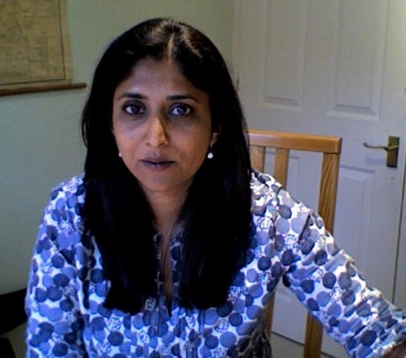
Foundation Training Manager - Surinder Bhatia
BPharm Kings College London University
Foundation Trainee year at UCH and Roche Products
Resident at Westminster/Chelsea & Westminster Hospital
PGCert Pharmacy Practice
Assistant Dispensary Manager/Resident UCH
Medicine Information Manager Chelsea & West Hospital
Prescribing Advisor in Primary Care
PGDip in Prescribing Sciences
Formulary pharmacist 2004 ENHT
Gastroenterology directorate pharmacist 2008
Foundation Trainee manager /Education & Training/
Academic Link with University of Hertfordshire
Post Graduate Certificate Education (HE)
Independent Prescriber
NHS Leadership Academy – Mary Seacole

Slide 14
Layout of the Foundation training year | Duration
Clinical – Induction | 8 weeks
Clinical – Longitudinal placement on one ward | 13 weeks
Clinical – Medical & Surgical wards | 5/6 weeks each
Medicines Information | 4 weeks
Aseptics & Oncology services | 2 weeks
Dispensary including dispensary manager for one week | 2 weeks & throughout year
Audit | 2 weeks
Community Pharmacy Placement | 2 weeks
Renal Medicine | 1 week
Paediatrics | 1 week
World Antimicrobial Awareness Campaign (WHO) | 1 week
Quality Control /Procurement, Stores & Distribution | 1 week
HEE training – taught sessions | 8 hours per month
Study time for self study /evidence collation for eportfolio /teaching sessions within ICS | Every Wednesday afternoon

Slide 15
Health Education England training programme
East of England region
Hertfordshire & West Essex ICS - Foundation Training Facilitator taught sessions
8 hours per month
Trainee – guided/self-directed
5 hours per month
Workplace teaching/support
1 hour per month BUT will be significantly more

Slide 16
Working hours
Working hours 9am-5pm
30 minute lunch break
One late shift per week 9am -730pm
30 minute lunch break
One early shift per week 9am – 3pm
1 in 8 Saturday and Sundays
REST DAY – 1 full day off after working a weekend
1 x 15 minute morning break and 1 x 30 minute break at 430pm
2 x 15 minute tea breaks, morning and afternoon

Slide 17
Our Expectations of you
Transitional year
Gradually take on the mindset of a pharmacist
Steep learning curve with lots of private study/paperwork
Be open to feedback and flexible (prepared to do anything)
Do not do anything that you are not competent/signed off to do it.
As a full time paid NHS employee, you will be expected to have an ‘’all hands on deck’’ attitude
Clinical pharmacy happens everywhere and can be applied in all rotations.

Slide 18
Learning contract - Trainee's undertaking
Abide by the GPhC Foundation Trainee scheme requirements & familiarise yourself with the learning outcomes required
Adhere to the rules and regulations
Take responsibility for your own learning and development
Admit to not knowing, understanding or being comfortable
Be honest in your interactions with your colleagues
Receive feedback and use it to help you to develop further

Slide 19
Learning Contract- tutor undertaking
Provide and arrange training that will enable you to develop so that you abide by the GPhC Foundation Trainee scheme requirements
Work with you to identify your individual learning needs
Enable you to have access to off-the-job study days and training events
Inform, support and confer with others involved in your training
Set aside time to review your progress regularly, informally & formally
Provide you with constructive and honest feedback
Assess you objectively - in all the GPhC Learning Outcomes
Assess a range of evidence which you provide, taking account of feedback from other people involved in your training

Slide 20
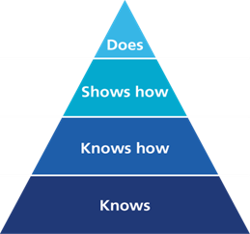
Interim Learning Outcomes & Recording Evidence
56 learning outcomes, organised into four domains:
• Person-centred care and collaboration
• Professional practice
• Leadership and management
• Education and research
Greater emphasis on DOES in Millers Triangle
Level 4 – Does is defined as :
Can act independently and consistently in a complex but defined situation. Evidence for this level is provided when a student pharmacist demonstrates the learning outcomes in a complex, familiar or everyday situation repeatedly and reliably. Assessments may require objective structured clinical examination (OSCEs) or other observed assessments.

Slide 21
Assessment Activities (21)
Group A: Clinical and patient-facing activities
1.Medicines optimisation
2.Medicines reconciliation
3.Consultations on medicines use
4.Consultation on diagnoses / assessment /recommendation
5.Patient safety activity
6.Patient focused health intervention
7. Medicines Query
Group B: Healthcare quality and improvement audit, teaching & mentoring, PH eg WAAW
Group C: Supplying medicines activities
legal aspects, dispensing (inc Aseptic prep), accuracy checks
Group D: Mandatory and specific training
first aid , safeguarding, H&S, digital systems, advanced therapy
Group E: Personal Development & Progression LNA/PDP, multisource feedback eg 360, other

Slide 22
Assessment Strategy
Assessment tools
MiniCEX,
DOPS,
MRCF,
CBD,
Contribution to care logs,
Peer assessment,
Reflective evidence,
dispensing, screening, checking and medicines reconciliation logs,
CPD
E-portfolio
HEE eportfolio
Further Resources
Health Education England
https://www.hee.nhs.uk/our-work/pharmacy/trainee-pharmacist-foundation-year-programme

Slide 23
Registration Assessment
Must be passed in order to register as a pharmacist
Allows the GPhC to protect the public by ensuring that registered pharmacists are:
Safe
Have sufficient knowledge and understanding to practice
Allowed three attempts
June and September sittings

Slide 24
Entry for the Registration Assessment
In order to be entered for the exam, a trainee must:
Achieve ‘satisfactory’ performance rating at 39 week appraisal
Not be absent from work for more than 40 days (bank holidays, annual leave and sickness combined)
Submit registration assessment entry form signed by tutor
Payment of assessment fee

Slide 25
The Registration assessment
Paper 1- Morning paper
40 calculations in 2 hours
Calculators allowed (specific model)
Space for rough working
Enter answers by hand
Units are likely to be provided
Paper 2- Afternoon paper
120 questions in 2.5 hours
Multiple choice questions
Some calculation questions calculator not required (number sense)
2 types of MCQs:
90 x single best answer
30 extended matching type
BNF not allowed but excerpts of the BNF/SPC provided for open book questions

Slide 26
Single best answer
Mr B who is 62 years old is suffering from an acute attack of gout. My B had a myocardial infarction 3 years ago and suffers from mild osteoarthritis, but is otherwise well. He is on the following medication:
Aspirin 75mg once daily
Atorvastatin 40mg once daily
Ramipril 10mg once daily
Co-codamol 30/500 two tablets up to four times a day as required.
He has no known drug allergies
What is the most suitable choice of drug for his acute attack of gout?
A allopurinol
B colchicine
C diclofenac
D etoricoxib
E febuxostat

Slide 27
Extended matching questions
A Codeine phosphate liquid
B Diclofenac suppositories
C Ibuprofen liquid
D Morphine sulphate tablets
E Oxycodone injection
F Paracetamol tablets
G Pethidine injection
H Tramadol tablets
For the patients described, select the most suitable analgesic from the list above. Each option may be used once, more than once, or not at all
A four year old boy, who has no long term medical conditions, has sprained his ankle earlier in the day and is experiencing mild pain. An ice pack was used immediately after the injury. The ankle is slightly swollen. The boy is allergic to penicillins.

Slide 28
The Registration assessment
Pass mark
Around 70%
Based on difficulty of the paper
Paediatric Questions
Constitute approximately 20% of questions
Trainee tip: become familiar with BNFc- body surface area, mean body weights and heights, general prescribing guidance, information at start of chapters and sections, licensing

Slide 29
Retention of trainees as band 6 pharmacists
We hope you will want to stay at Lister after your training year
In last 4 years 100% of trainees offered a band 6 with us after qualifying
Postgraduate Diploma in Pharmacy Practice opportunity available
Career progression opportunities post diploma available

Slide 30
Oriel Recruitment Key Dates
Foundation pharmacist training programme information available on Oriel 8 June 2022
Oriel applications open 8 June 2022 (12:00 GMT)
Oriel applications close 22 June 2022 (12:00 GMT)
Preferencing window opens 27 July 2022
Invitation to SJT/numeracy selection centre opens 3 August 2022
Invitation to SJT/numeracy selection centre closes 17 August 2022
SJT/Numeracy selection centre held (Pearson Vue test centres) 26 September - 7 October 2022
Preferencing window closes 31 October 2022
First iteration of offers made Early November
Offers upgrade deadline End of November
Programmes commence July/August 2023

Slide 31
Contact Information
For further information or to arrange a visit please contact
Surinder Bhatia via email surinder.bhatia@nhs.net or
Rachel Holland via email rachel.holland2@nhs.net
Trust website https://www.enherts-tr.nhs.uk/services/pharmacy/ for more information
Twitter @pharmacyENHT for Trust news and events

